Slide 1
Lecture 15 Hydrogen Applications

Slide 2
HYDROGEN APPLICATION

Slide 3
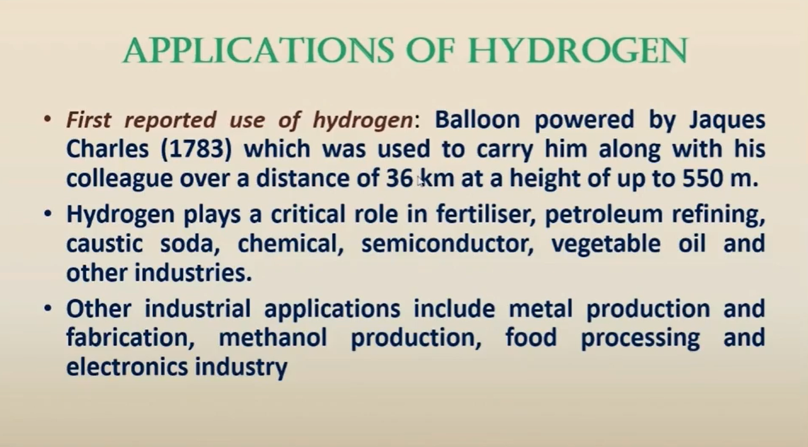
APPLICATIONS FOR HYDROGEN
First reported use of hydrogen: Balloon powered by Jaques Charles (1783) which was used to carry him along with his colleague over a distance of 36 km at a height of up to 550 m.
Hydrogen plays a critical role in fertiliser, petroleum refining, caustic soda, chemical , semiconductor, vegetable oil and other industries.
Other industrial applications include metal production and fabrication, methanol production, food processing and electronics industry

Slide 4
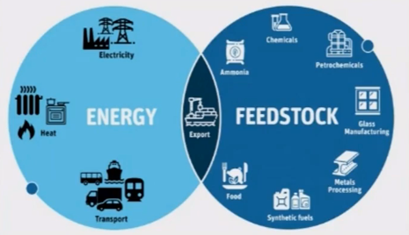
APPLICATIONS FOR HYDROGEN
Contd.
• Hydrogen is going to be used in the following sectors in the near future:
Stationery Power Generation
Gas grid interaction
As energy storage medium with variable solar and wind

Slide 5
Contd.
Industry
Fertilizer
Gas grid interaction for cooling or healing of buildings
Iron and Steel
Food Processing
Petroleum and petrochemical
Float glass
Chemical
Household application like cooking,heating,cooling, etc
Transport
Internal Combustion Engine (ICE) Vehicles
Fuel Cell (FC) Vehicles
Domestic
Power
Storage medium for solar and Wind
Stationery Power Generation Via Fuel Cell
Cooling of Generators in thermal power plants

Slide 6
APPLICATION IN INDUSTRY
It is used widely in the following industries:
Petroleum refinery and petrochemical industry
Petroleum refineries carry out many industrial processes that transform crude oils into valuable products such as gasoline, jet fuel, diesel,kerosene, liquified petroleum gas, naphtha etc
In Petrochemical industry, hydrogen is extensively used for production of many chemicals such as: acetic acid, butanediol, tetrahydrofuran, butyraldehyde, hexamethylene diamine, cyclohexane etc.
Hydrogen is also used in polymer synthesis to control molecular weight of polymer such as polypropylene

Slide 7
Contd.
Fertilizer Industry
This industry mainly dependent on Ammonia which is produced by
reaction between nitrogen and hydrogen by Haber-Bosch process.
N2(g) + 3H2(g) 2NH3(g) ; p=150-250 bar,
T: 450-500 oc
Ammonia generated by this process is used to produce nitrogen
based single nutrient fertilisers such as ammonium nitrate
(NH4N03), urea [CO(NH2)2] and other ammonium nitrate salts.
These fertilisers are further mixed with phosphorus (P) and/or
potassium (K) based fertilisers to obtain binary (NP/NK) and ternary
(NPK) fertilisers

Slide 8
Contd.
Metal Industry
Tungsten is extracted from its ore (W03) using hydrogen
reduction method
WO3 + 3H2(g) W + 3H20 (g) T: 550-850 oc
Direct reduction of iron and other metals such as copper is
possible using hydrogen as reducing agent instead of carbon.
Trials of iron production by to implementing hydrogen
reduction method are likely to be completed by 2024 by Luleå Steel, Swedish plant.

Slide 9
Hydrogenation process in Vanaspati production
Contd.
Hydrogen has been used extensively to decrease the degree of unsaturation in fats and oils and to turn unsaturated fats to fully or partially saturated oils and fats.
Hydrogenation process is performed in a heated tank under vacuum at around 140 — 2500C under a catalyst (mostly nickel based solid catalyst) and the hydrogen gas (at 2.7 — 4 bar pressure)
Palm oil, sunflower seed or olive oil is used as oil feed for this process

Slide 10
Float glass industry
Float glass is a specialised type of glass with an extremely smooth and uniform structure with excellent optical properties
It is ued for a wide variety of applications including windows, solar panels, LCD displays and automotive windscreens
Hydrogen is extensively used as reducing agent in the manufacturing process of float or plate glass.

Slide 11
APPLICATION IN HOUSEHOLD
Gas grid interaction for cooling or heating of buildings
Main source: Natural Gas (NG)
Consumption of huge amount of NG annually
Blending of Hydrogen in existing NG networks is possible
It could significantly reduce environmental impact caused by the use
of fossil fuels
20 % blending of Hydrogen in existing network has been made in UK
For the sake of simplicity, if we blend 5% of hydrogen in 49 the city gas
network in India that used about 4.27 MT of natural gas during 2018-
19, about 0.21 MT of hydrogen would be needed

Slide 12
Contd.
Local district networks could also use hydrogen for cooling and heating
their building networks
In household applications, use of hydrogen will replace/ reduce LPG or
natural gas dependency for cooking, cooling and heating.

Slide 13
APPLICATION IN POWER
Huge potential for use of hydrogen in power sector for electricity
generation using fuel cells, conventional ICE, hydrogen-fired gas
turbines and combined-cycle gas turbines
Power industry is highly confident that gas turbines entirely run-
on hydrogen could be developed by 2030
Gas mixture containing 3-5% hydrogen could be used, in the
current gas turbine technology,
Successful demonstration by Mitsubishi Hitachi Power Systems:
maximum of 30% hydrogen gas mixture in a modified gas turbine
was performed

Slide 14
Contd.
Hydrogen is an excellent energy storage medium with variable renewable power generation systems based on solar and wind and FC using stored hydrogen could be used for power generation, depending on needs
FC technology having efficiencies of about 50%, an aggregate capacity of 1 MW operating with 70% capacity utilisation would need about 372 tonnes of hydrogen per annum
FC uhits have been mostly installed in Japan, Germany, Korea and the United States
Current global installed capacity using FC for power Generation stands 1.6 GW
Japan aims to reach 1 GW of power generating capacity based on hydrogen by 2030

Slide 15
• Korea has a goal of 1.5 GW installed FC capacity in the power sector by
2022 and 15 GW by 2040
• Thermal power plant's generator cooling
Hydrogen as coolant has several advantages such as, low density; high thermal conductivity; high specific heat capacity; and cleaner than the air
Hydrogen used for power plant cooling is at a pressure of around 4 bar
Hydrogen absorbs heat from power generating winding enclosure
The amount of hydrogen used per day is a function of capacity of
the power generator and condition of hydrogen seal
Requirement of Hydrogen for cooling: 1. brought in cylinders
2. on-site production
using electrolysers

Slide 16
Issues: 1. replenishment of more hydrogen to maintain the pressure
for optimal heat transfer due to leakage at high pressure
2. maintaining purity of hydrogen above a particular level
from safety consideration
Around 135 coal based thermal power plants are operating in India
Capacity of thermal power plant could be found in the range of 55 MW to 4760 MW
The power plants consisting of several small units and their capacity varies between 50 MW to 800 MW.
Total number of such thermal power generating units in the country was 531 as on 01.04.2020
They can be categorised in four ranges as per their hydrogen consumption for generator cooling:
a. <150 MW b. 150-250 MW
d. 400 - 800 MW c. 250-400 MW

Slide 17
APPLICATION IN TRANSPORT
Hydrogen Fueled Vehicle
Internal Combustion
Engine (ICE) Vehicles
Fuel Cell Vehicles
Dual Fuel ICE Vehicles
100% Hydrogen ICE Vehicles
Hydrogen – CNG
Vehicles
Hydrogen – Diesel
Dual Fuel
Vehicles
Classification of hydrogen Fuelled Vehicles

Slide 18
Thank You

